Slide 1
Operation: Awesome
Matthew Branstetter
Vernon Jones
Yusuf Qedan
Tyler Tricker

Slide 2
Motivation
To design a project that follows current standards and practices used in industry
Develop team cohesion and work on communication skills

Slide 3
Objective
To create a blinking Frisbee that adheres to the project requirements and specifications
Have a working project and demonstrate at the completion of Fall term

Slide 4
Alternatives
WHAMMO Frisbee Disc Twilight Blast - $19.99
  150 grams
  2 LEDs diffused through plastic
  Runs off of 3 LR44 batteries
Flashflight - $19.99
  185 grams
  1 super right LED diffused through plastic
  Runs off of 2 CR2016

Slide 5
Requirements
Have one or more inputs or sensors
Have one or more outputs or transducers
Have one or more processor modules
Two layer PCB
Have components that can be hand soldered or easily soldered in a crude reflow

Slide 6
Our Approach
Our method was a top down approach to design
Broke the project into interface module and LED module
Developed modules independently
Then combined the two on completion for the final design

Slide 7
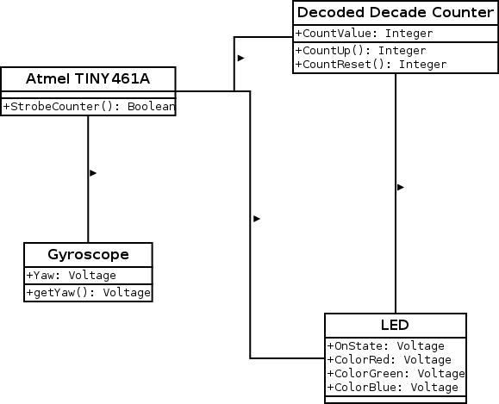
Design: UML

Slide 8
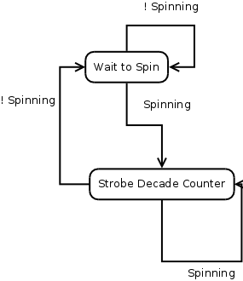
Design: UML

Slide 9
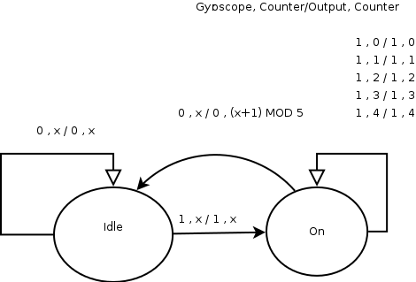
Design: Software Algorithm

Slide 10
Light-up Frisbee Level 0 Block Diagram
Light-up Frisbee
Power 5-7V
10 RGB LEDs
Module | Light Up Frisbee
Inputs | Power 6V from 2 lithium batteries
Outputs | 10 RGB LED’s 40 pins common anode configuration
Functionality | Based on the measured angular velocity 10 RGB LEDs will light up different patterns and colors

Slide 11
Light-up Frisbee Level 1 Block Diagram
Logic Power Supply
Power 5v-7V
3.3 V
Lighting Module
3.3 V
Row
Strobe
and
Reset
RGB
LED Outputs
Logic Module
Red Column
Blue Column
Green Column

Slide 12
Logic Power Supply: Level 0 Block Diagram
Logic Power Supply
Power 5-7V
Power 3.3V
Module | Logic Power Supply
Inputs | Power 5-7V from 2 lithium batteries
Outputs | Power 3.3V
Functionality | Maintains a constant output voltage of 3.3V

Slide 13
Logic Power Supply: Level 1 Block Diagram
Voltage Regulator
Power 5-7V
Diode
Power 3.3V
Cap
Cap
Decoupling

Slide 14
Logic Module: Level 0 Block Diagram
Logic Circuit
Row Strobe
Row Reset
Power 3.3V
Red Column
Blue Column
Green Column
Module | Logic Circuit
Inputs | Power 3.3V
Outputs | Row Strobe – Signal to the lighting circuit to activate the next LED. | Red Column – Turn Red on or off
 | Row Reset - Signal to the lighting circuit to return to LED0. | Blue Column –Turn Blue on or off
 |  | Green Column – Turn Green on or off
Functionality | Measures a rotational velocity and outputs lighting signals as a function of the rotational velocities value.

Slide 15
Logic Module: Level 1 Block Diagram
Gyroscope
Power 3.3V
ZOUT
ATTINY461A
Row Strobe
Row Reset
Red Column
Blue Column
Green Column

Slide 16
Lighting Module: Level 0 Block
5-7 V
3.3 V
Lighting Module
Row
Strobe
and
Reset
RGB
LED Outputs
RGB
Strobe
Module | Logic Circuit
Inputs | Row Strobe – Signal to the lighting circuit to activate the next LED. | Red Column – PWM for red brightness
 | Row Reset - Signal to the lighting circuit to return to LED0. | Blue Column – PWM for blue brightness
 |  | Green Column – PWM for blue brightness
Output | 10 RGB LED Outputs
Functionality | Takes lighting signals from the Logic Module and pulses LEDs according to the signal

Slide 17
Lighting Module: Level 1 Block Diagram
5-7V
3.3 V
4017 Decade Decoder
Transistor Array
Row
Strobe
and
Reset
RGB LED
Anode
Outputs
Transistor Array
Current
Limiter
RGB
Strobe
Red Column
Green Column
Blue Column

Slide 18
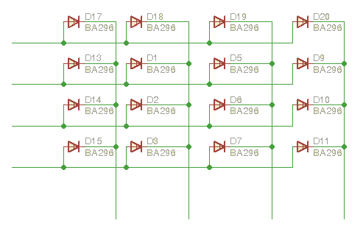
Lighting Design Selection
Matrix Layout

Slide 19
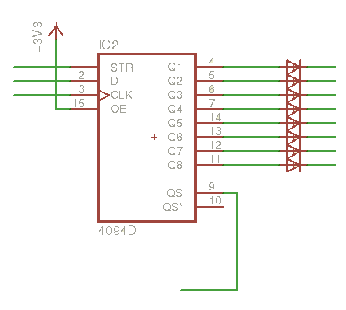
Lighting Design Selection
Shift Register Layout

Slide 20
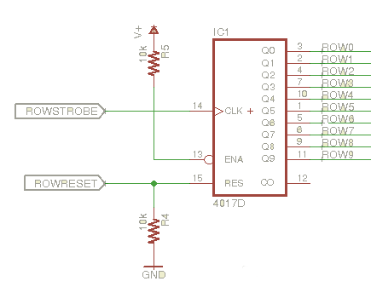
Lighting Design Selection
Counter layout

Slide 21
Design: Decisions Made
Processor module – AVR suggested
  AT mega
    256KB flash
    28-100 I/O pins
    20 MHz
  AT tiny
    8KB flash
    6-32 I/O pins
    20 MHz
Decision: AT tiny461A

Slide 22
Design: Decisions Made
Gyro Sensor
  Digital
    Interface with Processor module
    Expensive
  Analog
    AVR Analog/Digital converter
    Cheaper
Decision: STMicroelectronics LY3200ALH

Slide 23
Design: Decisions Made
Power Supply
  LM1117 3.3V fixed LDO
    Readily Available
    Used frequently
Decision: LM1117 3.3V fixed LDO
  Battery
    CR123 – 1500mAh (Lithium)
    CR2032 – 250mAh (Lithium)
Decision: CR2032 X 2 (6.6V)

Slide 24
Design: Decisions Made
LED
  Time Division Multiplexing on LED's
    4017 Johnson counter with decoded outputs
    MosFET drivers
    Adjustable Pots on RGB Channels for different LED foreword voltages
  Support RGB LEDs

Slide 25
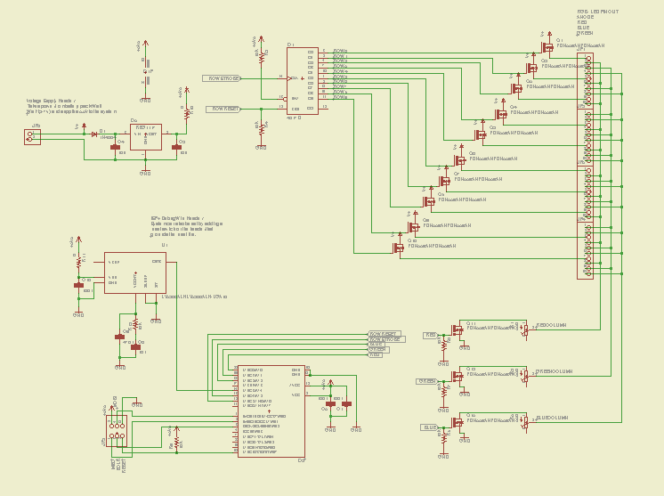
Implementation:
Schematics

Slide 26
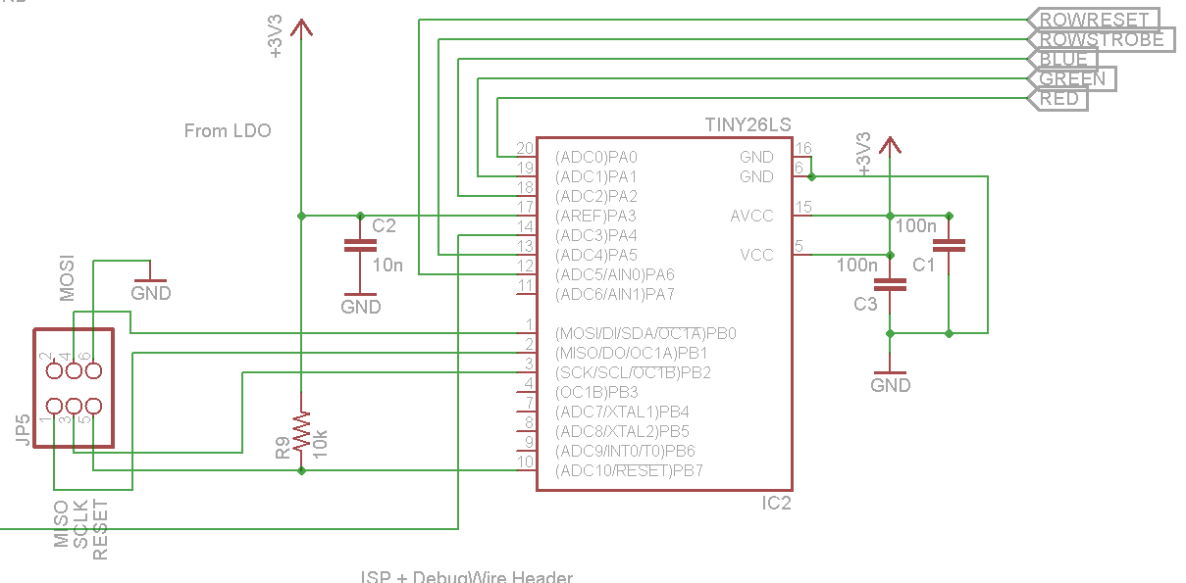
Implementation:
Microcontroller

Slide 27
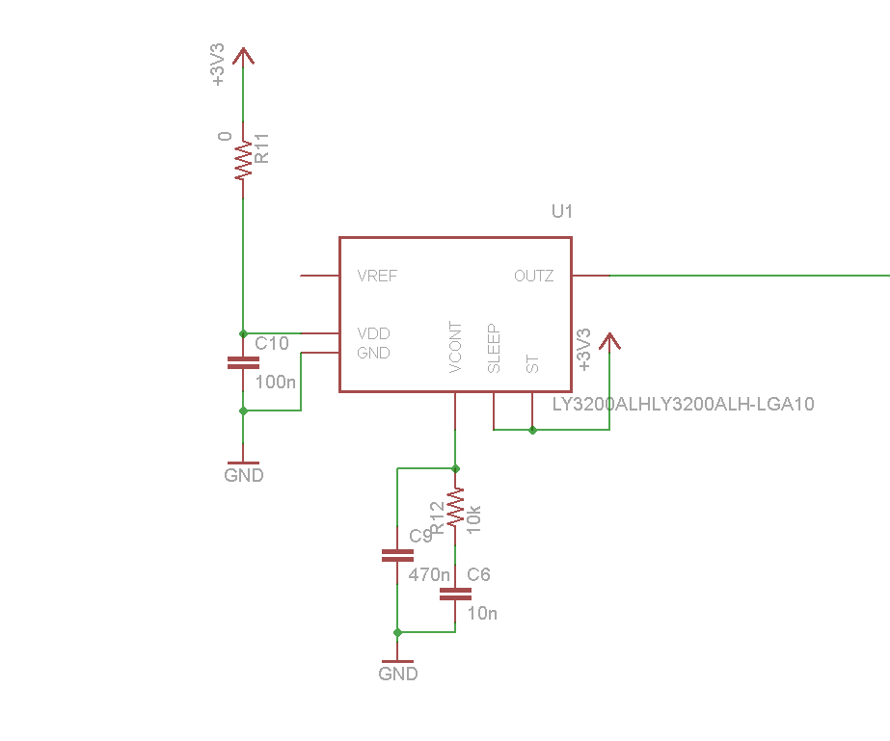
Implementation:
Gyroscope

Slide 28
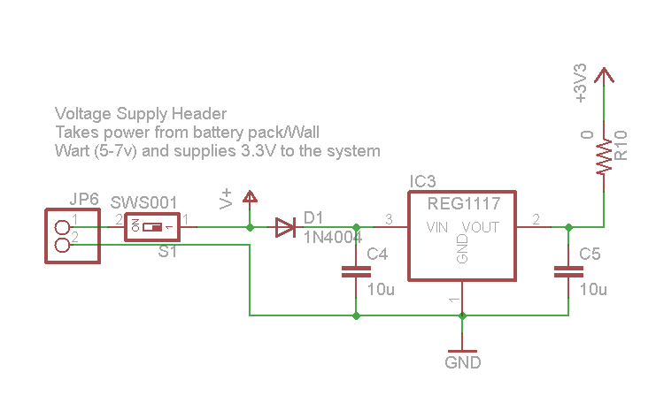
Implementation:
Power System

Slide 29
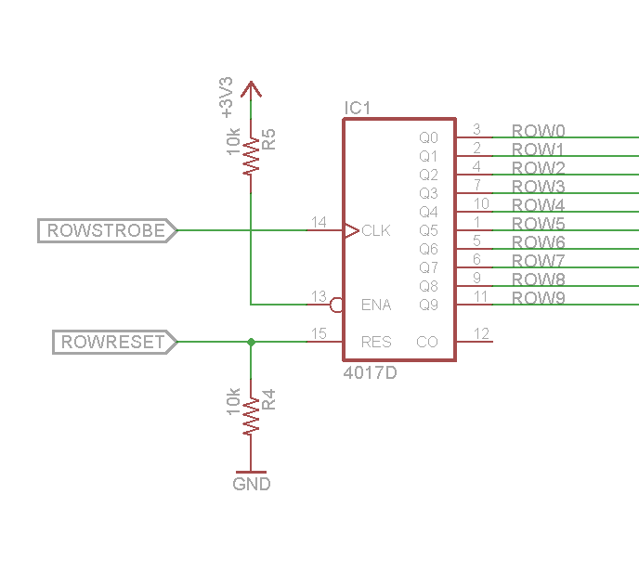
Implementation:
Decade Counter

Slide 30
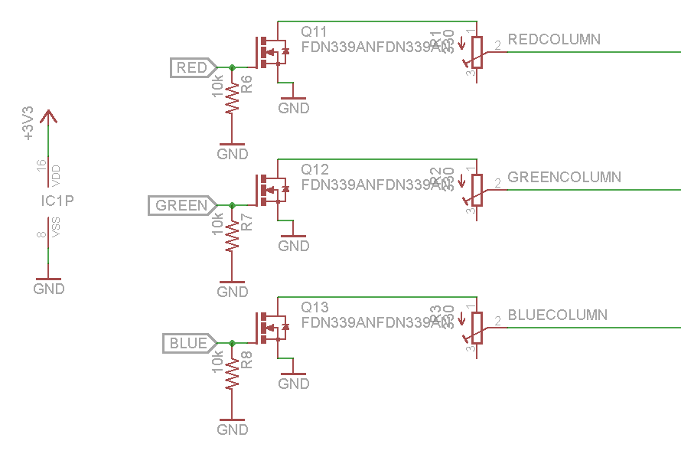
Implementation:
Red, Blue, Green

Slide 31
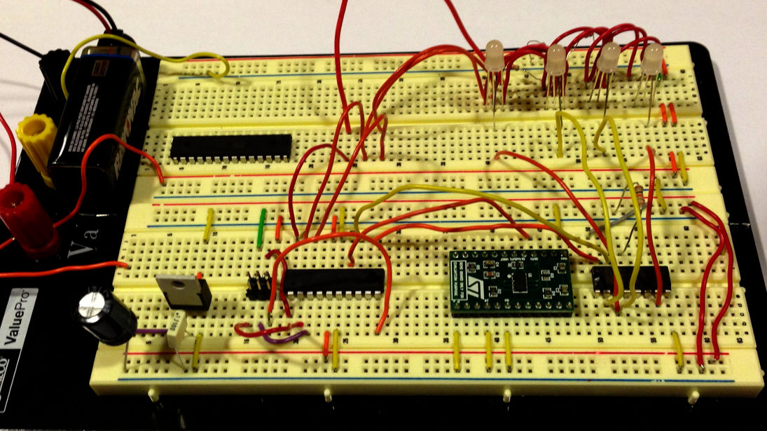
Prototyping

Slide 32
Prototyping:
Spinning with Gyroscope

Slide 33
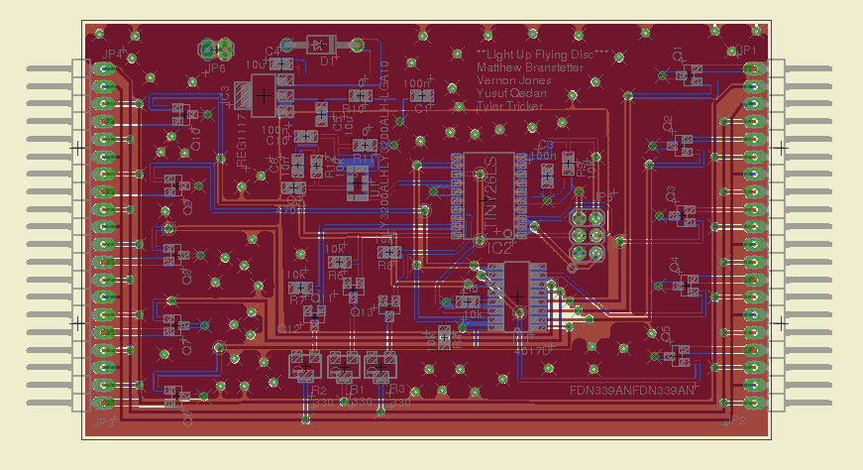
Implementation:
PCB

Slide 34
Implementation:
Tools Employed
EAGLE CAD
AVR Studio 6.0
Gantt Project/Microsoft Project
Libreoffice

Slide 35
Implementation:
Tools Employed
Skype
Git
Redmine
AVRISP MKII Programmer
AVR JTAG ICE3 Programmer/Debugger

Slide 36
IP, Prior Work
Component Datasheets
No other IP or prior work used

Slide 37
Testing
Power Test: Check for bridges between Power, Ground, and 3.3V
LED Test: Light up a single LED
Scheduler Test: Light up all LEDs a single color
Color Test: Light one LED at a time, Red, Green, then Blue
Gyro Test: Light LEDs based on Gyro State

Slide 38
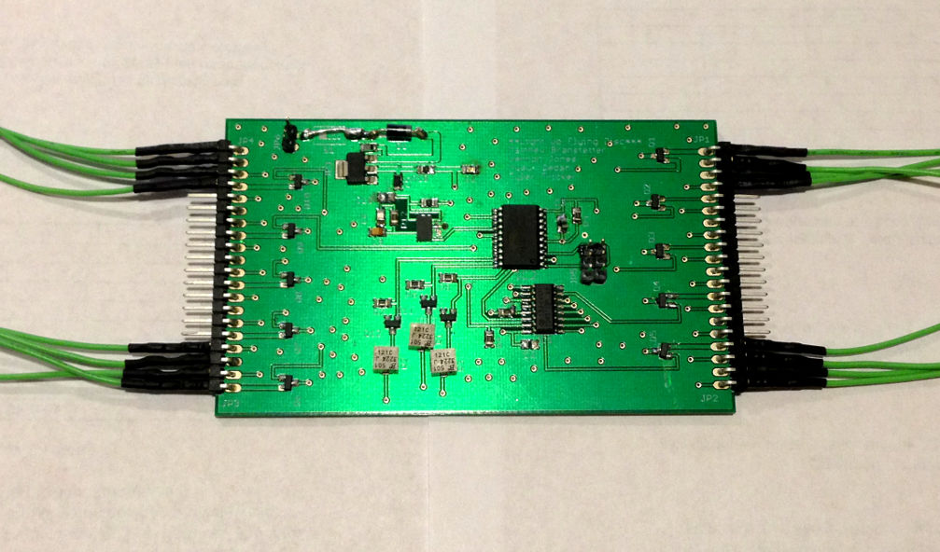
Results

Slide 39
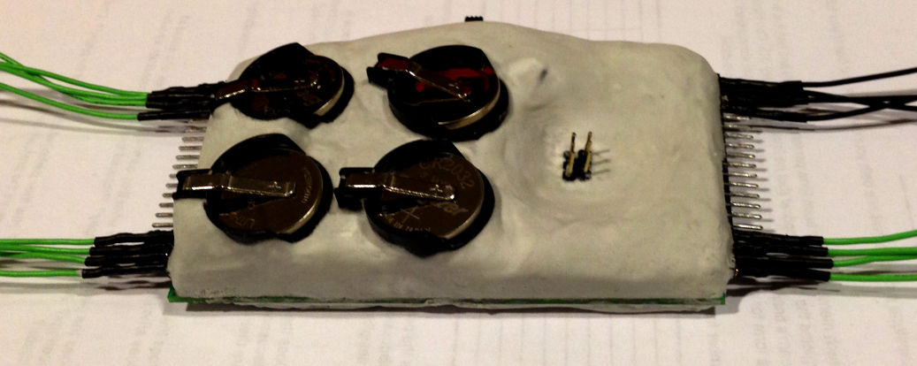
Results

Slide 40
Modifications to Board Layout

Slide 41
Board Demo Videos

Slide 42
Contributions
Matthew: Interface Module
Vernon: Programming
Yusuf: Test Plan, Components
Tyler: PCB Layout, LED module

Slide 43
Lessons Learned:
Reflow: One board at a time
Reflow: Main components and hand-solder capacitors, resistors, and MOSFETs
Don't reflow on through-hole components
Slow is Fast
More thorough test plan

Slide 44
Circuit Improvements
9V battery – Board density
Angled power and ISP headers
More 0-ohm resistor jumpers
LED headers – all four sides
LEDs directly on PCB
Separate large components from small
Higher gate voltage

Slide 45
Questions?

